Slide 1

Supply Chain
Data Analysis Project

Slide 2
Team Members
- SAYALI
- PRERNA
- VAISHNAVI
- SHIVANI
- SAURABH
- TANMAYA TEJA

Slide 3
Agenda
- Overview of Project
- Data Sources
- Tools Used
- Analysis Steps
- Key Performance Indicators (KPIs)
- Dashboards
- Conclusion

Slide 4
Introduction
The Supply Chain project is aimed at providing a comprehensive and real-time overview of the organization's supply chain dynamics. In the rapidly evolving business landscape, effective supply chain management is crucial for success. This project seeks to leverage data analytics to enhance decision-making, optimize operational efficiency, and identify growth opportunities within the supply chain.
Objective
The primary objective of this project is to create a dynamic and interactive dashboard that consolidates key performance indicators (KPIs) related to the supply chain. This dashboard will enable stakeholders, including management, analysts, and decision-makers, to gain valuable insights into various facets of the supply chain, facilitating informed and timely strategic decisions.

Slide 5
Data Sources
Calendar Dataset
Customer Dataset
Countries Dataset
Product Dataset
Store Dataset
Inventory Dataset
Point of Sales Dataset
Sales Dataset
Plugs Electronics Hands on Lab Dataset

Slide 6




Tools Used
Excel
MySQL
Tableau
Power BI

Slide 7
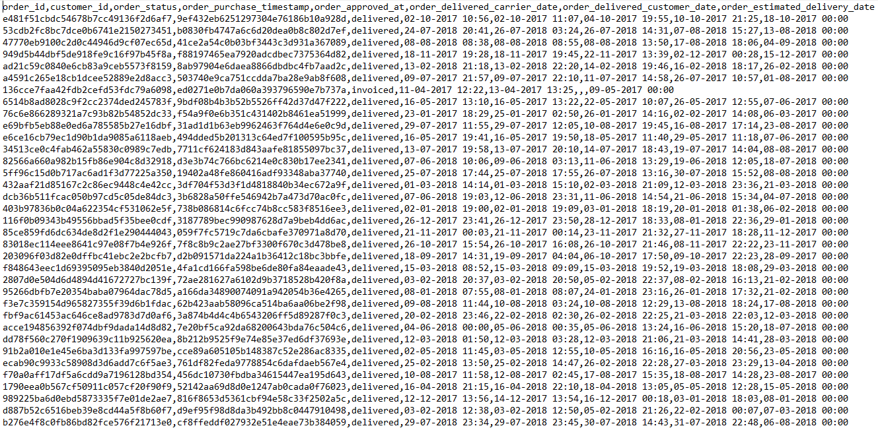
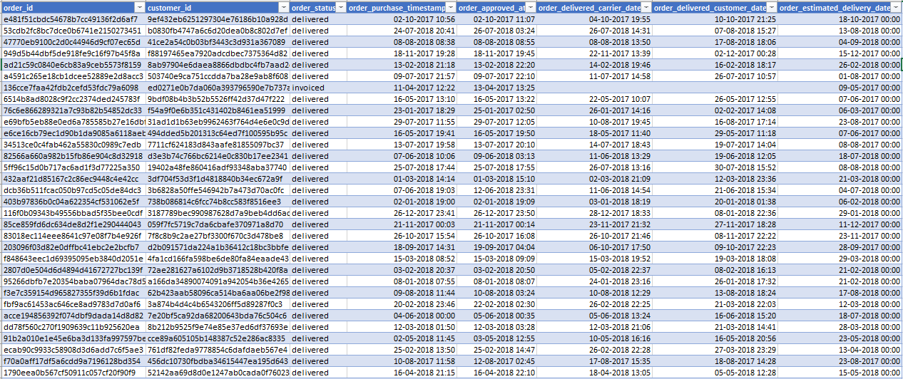
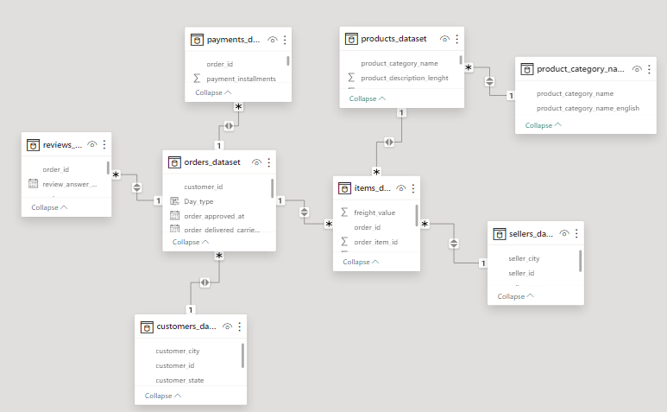
Analysis Steps
- Data Understanding
- Data Cleaning
- Data Modelling
- Data Processing & Analyzing
- Data Visualization

Slide 8
Key Performance Indicators (KPIs)
Total Sales (MTD, QTD, YTD)
Insights
Sales consistently increasing monthly, with total reaching $388,133,203.8.
Significant monthly and quarterly growth, highlighting a positive YTD trend.
MTD sales at $169,4493 indicate a strong start for the current month.
Next Steps
Identify factors driving sales growth for potential scaling.
Explore opportunities for targeted promotions to boost MTD sales.
Evaluate the effectiveness of current sales strategies for sustained growth.
26.1M
YTD
24.4M
QTD
1.7M
MTD

Slide 9
Key Performance Indicators (KPIs)
Sales Growth
Insights
Notable growth from 2019 to 2022, with a significant spike in 2023.
2023's sales contribute to YTD total, indicating potential for continued growth.
Historical growth offers a benchmark for setting future sales targets.
Next Steps
Understand drivers behind each year's growth.
Set realistic sales targets based on historical growth.
Align marketing and sales strategies with growth patterns.

Slide 10
Key Performance Indicators (KPIs)
Daily Sales Trend
Insights
Monthly variations in sales, with February and March consistently showing high figures.
December consistently strong, suggesting a holiday season impact on sales.
Understanding monthly trends aids in proactive marketing and inventory planning.
Next Steps
Plan targeted promotions during peak months.
Optimize inventory to meet fluctuating demand.
Evaluate the impact of external factors on monthly trends.

Slide 11
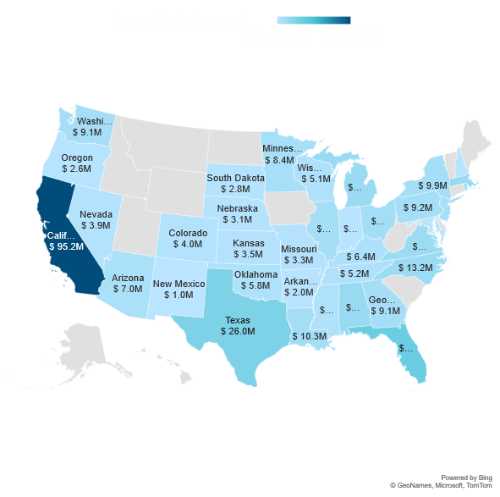
Key Performance Indicators (KPIs)
State wise Sales
Insights
California, Florida, and Texas are top sales contributors, emphasizing key regional markets.
Varied sales across states indicate potential for targeted regional strategies.
Opportunities for expansion or intensified marketing efforts in high-performing states.
Next Steps
Tailor marketing strategies to capitalize on state preferences.
Assess expansion opportunities in high-performing regions.
Monitor and adapt strategies based on regional sales patterns.

Slide 12
Key Performance Indicators (KPIs)
Store wise Sales (Top 5)
Insights
Tilloch Store leads in sales, indicating a successful store strategy.
Varied sales across stores provide insights into successful practices.
Strategies from top-performing stores can be replicated for improved overall performance.
Next Steps
Analyze successful practices of top-performing stores.
Implement successful strategies in other stores.
Foster healthy competition among stores for improved performance.
$6.2M
$6.1M
$5.3M
$5.1M
$4.9M

Slide 13
Key Performance Indicators (KPIs)
Region wise Sales
Insights
South and West regions dominate in sales, influencing regional strategies.
Understanding regional preferences aids in tailoring marketing approaches.
Opportunities for regional expansion or intensified presence in high-performing areas.
Next Steps
Customize marketing and inventory strategies based on regional preferences.
Explore opportunities for targeted regional promotions.
Assess potential for expansion or increased presence in top-performing regions.

Slide 14
Key Performance Indicators (KPIs)
Total Inventory and Inventory value
Insights
The total inventory count is 2,404,441 units, indicating a substantial volume to manage.
The inventory value is $419,006,606.2, representing a significant asset.
Next Steps
Implement efficient inventory management systems to prevent overstock or understock situations and ensure optimal product availability.
Regularly reassess inventory value and adjust procurement strategies to maintain a healthy balance between supply and demand.
#2.4M
Total Inventory
$41.9M
Inventory Value

Slide 15
Key Performance Indicators (KPIs)
Overstock, Out stock and Understock
Insights
Low counts of overstock, understock, and out stock indicate effective inventory control.
Proactive measures to prevent overstock and understock situations are in place.
Ongoing monitoring of stock levels crucial for maintaining a balanced inventory.
Next Steps
Continue close monitoring of stock levels.
Adjust procurement strategies to prevent overstock and understock situations.
Implement proactive measures to avoid stockouts.
138.9K
Overstock
1.8K
Out stock
59.7K
Understock
Total Stock

Slide 16
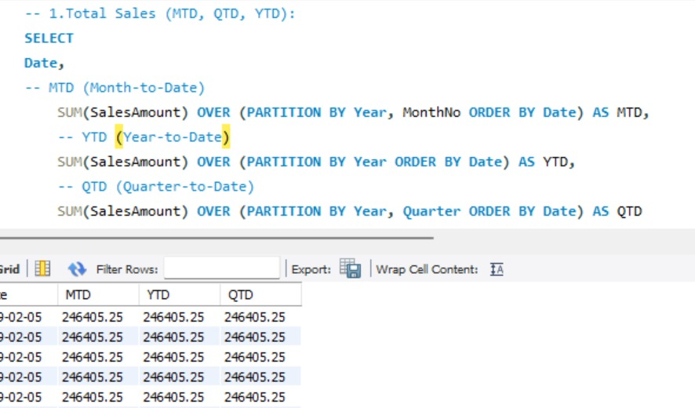
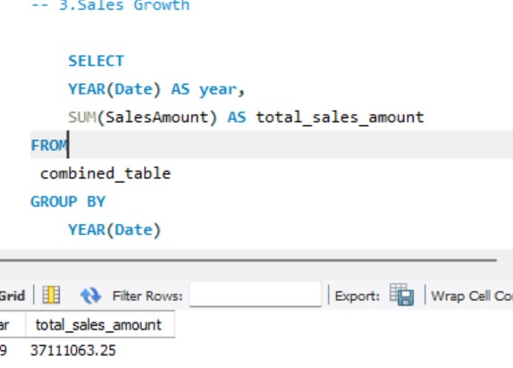
MySQL Queries
Total Sales (MTD,QTD,YTD)
Sales Growth

Slide 17
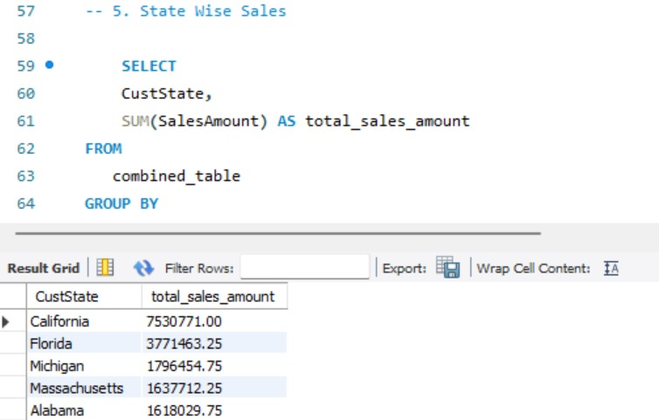
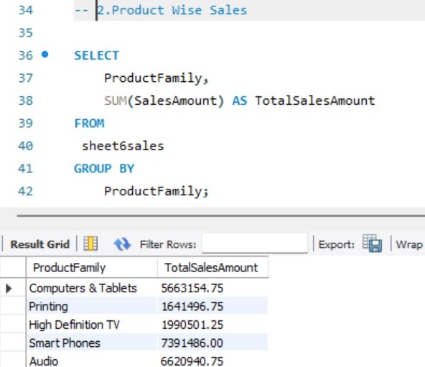
MySQL Queries
State wise Sales
Product wise Sales

Slide 18
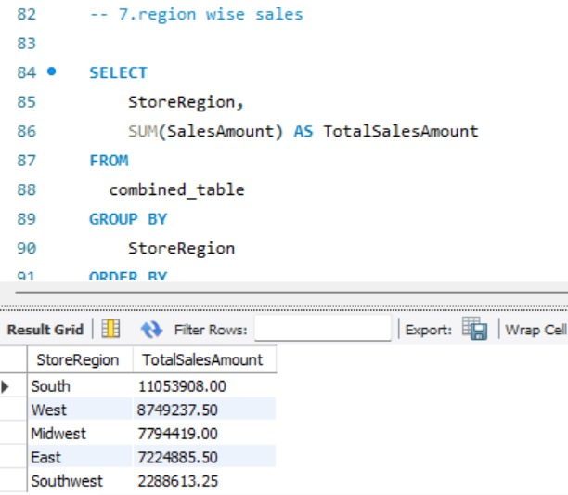
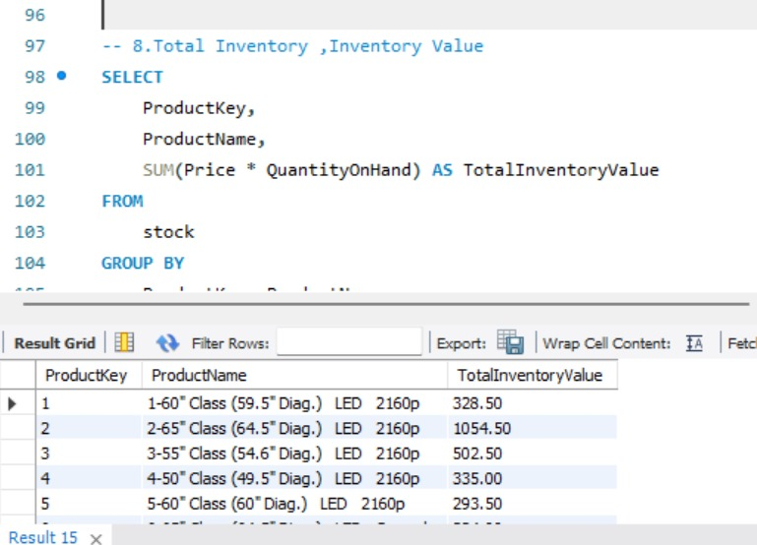
MySQL Queries
Region wise Sales
Total Inventory & Value

Slide 19
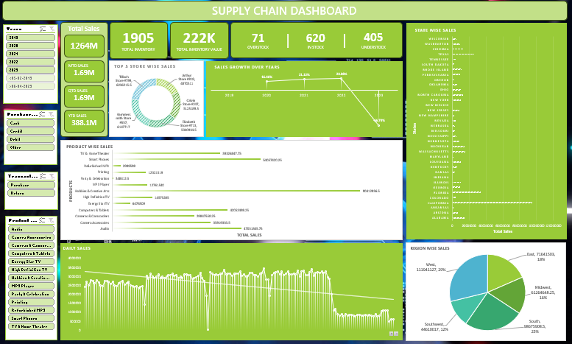
D A S H B O A R D

Slide 20
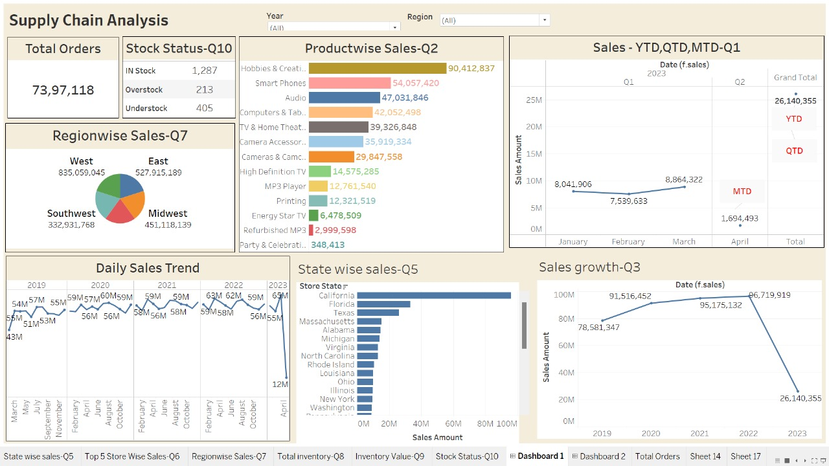
DASHBOARD

Slide 21
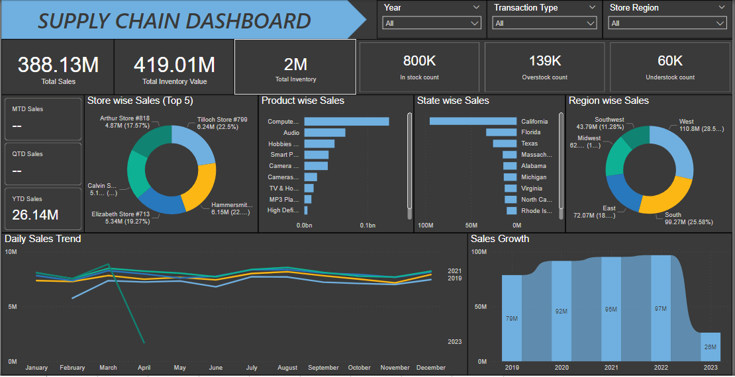
DASHBOARD

Slide 22
Conclusion
Overall, the supply chain demonstrates strong performance with consistent sales growth.
Key focus areas include targeted marketing, understanding regional nuances, and refining inventory management.
Continued analysis and adaptation to trends will ensure sustained success.

Slide 23
Thank You !

